Slide 1

Advanced Java Workshop
Presenter:
Charles Cao, Founder of Service ECVictor Inc.
ccao@ecvictor.com
Master in ECE 2010
Sr. Software Development Engineer in Expedia
10+ Software development experience

Slide 2
Java SE
When most people think of the Java programming language, they think of the Java SE API. Java SE‘s API provides the core functionality of the Java programming language. It defines everything from the basic types and objects of the Java programming language to high-level classes that are used for networking, security, database access, graphical user interface (GUI) development, and XML parsing.

Slide 3
Java EE
The Java EE platform is built on top of the Java SE platform. The Java EE platform provides an API and runtime environment for developing and running large-scale, multi-tiered, scalable,reliable, and secure network applications.

Slide 4
Java EE
Specifications of standard API
  Defined by the Java Community Process (JCP)
      Java Specification Requests (JSRs): proposed and final specifications
  Different implementation of same API
      Example: JPA is implemented by Eclipselink, OpenJPA, Hibernate
Certifications
Architecture pattern
  Large scale
  Multi-tiers (Presentation Logic, Business Logic, Persistence)
  Scalable
  Reliable
  Secure

Slide 5
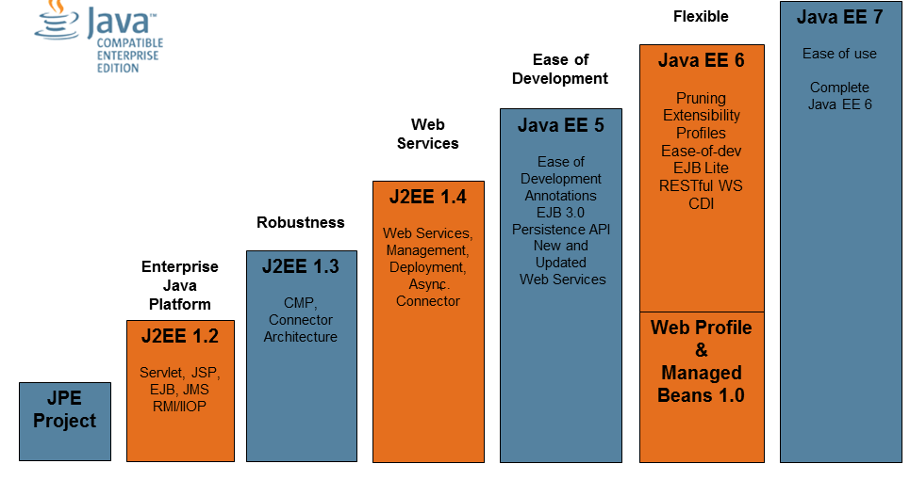
Java EE

Slide 6
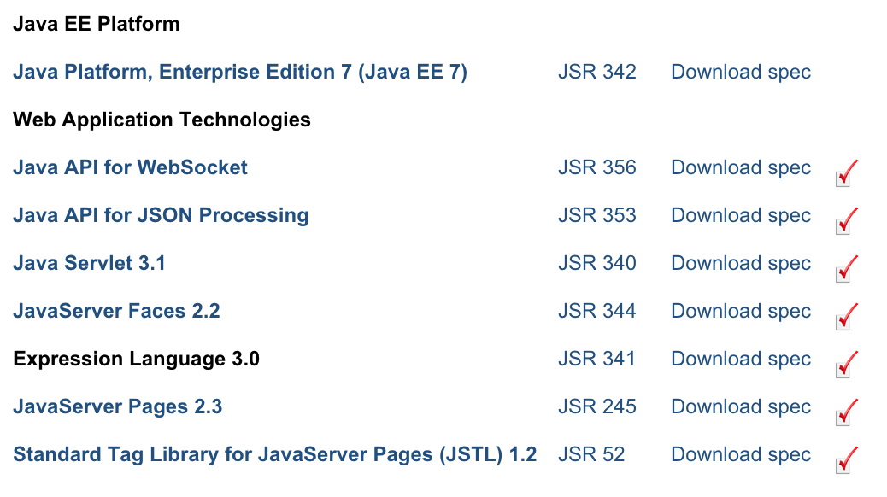
Java EE 7 (JSR 342)

Slide 7
Java EE architecture
Presentation Tier
Business Logic Tier
Data (EIS) Tier
Java EE Server
Web Container
Web Browser
Servlet
JSP Page
Servlet
JSP Page
Database
Application
Client
EJB Container
Enterprise
Bean
Enterprise
Bean
Enterprise
Bean
Client

Slide 8
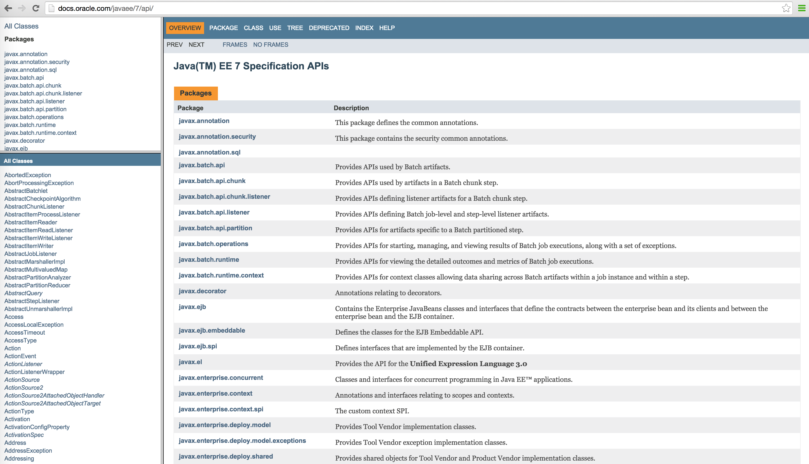
Java EE 7 APIs

Slide 9
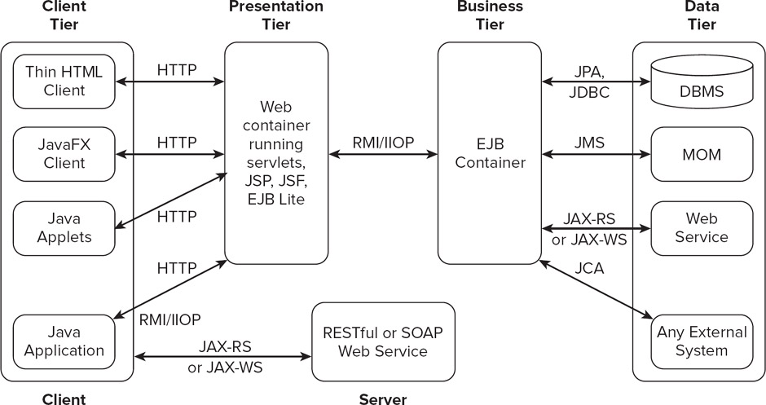
J2EE APIs – The big picture

Slide 10
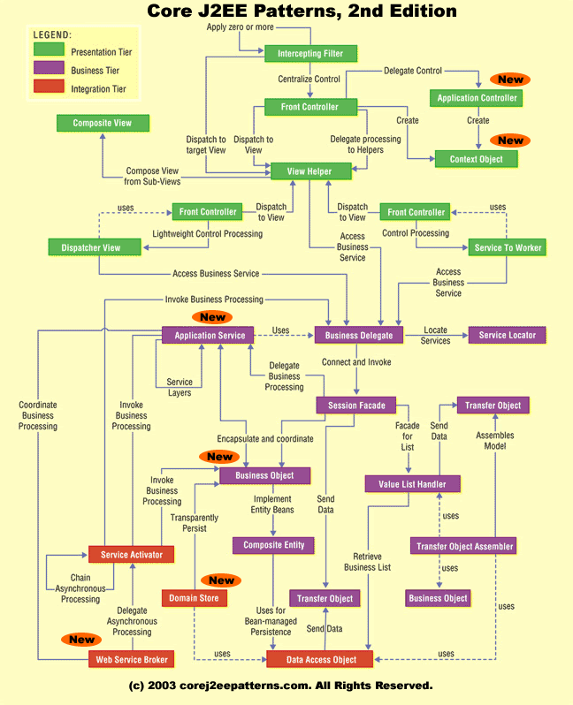
Core J2EE Patterns

Slide 11
Java EE Packaging
jar – EJB Module
war – web module
normally contain several Servlets, JavaServer Pages and other Web resources e.g. HTML files, graphics files, audio files and movies
jar – Application Client
rar – Resource Adapter Module

Slide 12
Questions?
THANK YOU!
MERCI!

